Slide 1
C-Programing for Microcontrollers
Dr. Amr Talaat

Slide 2
Introduction
C - Language is very efficient language to use especially with the hardware. It is similar to the languages we used to write before with little bit differences. And it has also
Loops.
Conditional Statements.
Switch Cases.
Variables and Data types.
Objects.
Arrays.
It is similar to the other languages we have learnt before which makes us familiar with the syntax to a further limit.

Slide 3
Outline
Software installation
Include statement and definition statements
Main method and file structure
Variables and data types
Arrays
Conditional statements
Loops and iteration statements
Registers names and data direction
Methods
Operators
Examples

Slide 4
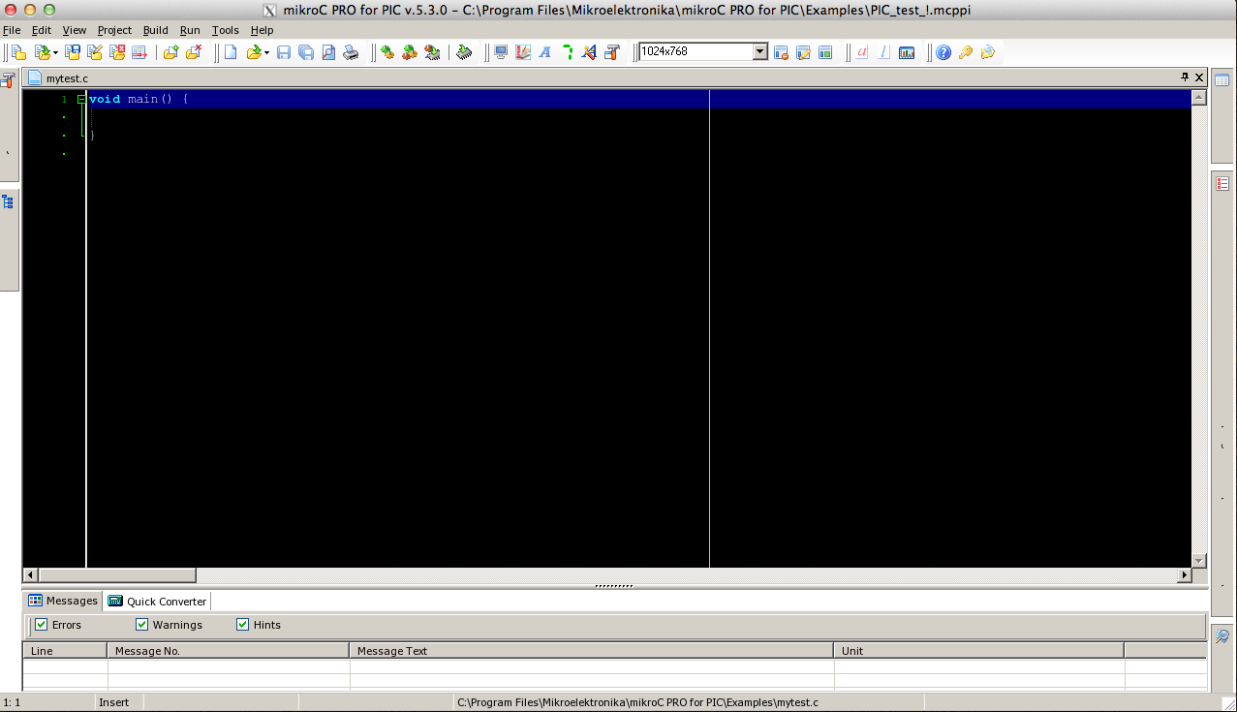
(1) S/W Installation
This software is called MikroC for PIC which you can download from the following link
http://www.mikroe.com/eng/products/view/228/mikroc-pro-for-avr/
It would be used to simulate C-programs in PIC microcontrollers

Slide 5
Outline
Software installation
Include statement and definition statements
Main method and file structure
Variables and data types
Arrays
Conditional statements
Loops and iteration statements
Registers names and data direction
Methods
Operators
Examples

Slide 6
(2) Include and definitions
Do you remember this line
import java.io.*;
In the previous java courses we used this line to import some predefined classes in java to be used in the active class we are working through
But, How we could do the same in C- Language?
#include <h_file> ;
It could be done using the #include statement to include one of the header files (h_files) that have all the microcontrollers predefined functions and register names

Slide 7
(2) cont.
#include <file.h>
C- Library
Predefined elements are ready for the class
Header File
C- Class

Slide 8
(2) cont.
Also You Can FIND in C- Language
#define X Y ;
It is used to define variable called X to have the same value or behavior as variable Y and this can be realized in
Example (2.1)
#include <pic16f877a.h> ;
/* this makes the header file for the PIC16f877 ready to be used in the C-class */
#define LED PORTC ;
/* defines LED variable in the class to work as PORTC so what happens to LED will be applied on PORTC */

Slide 9
Outline
Software installation
Include statement and definition statements
Main method and file structure
Variables and data types
Arrays
Conditional statements
Loops and iteration statements
Registers names and data direction
Methods
Operators
Examples

Slide 10
(3) Class structure and main
The C Class consist of the following
#include <pic16f877a.h> ; // header file include
#define LED PORTC ; // define LED as PORTC
void main ( void ) // main method
{
// main method implementation and print test
printf(“hellow World”);
}
Main method is the one responsible for organizing the class methods and variables. It can call any other method inside
void means it won’t return any value because it is the main one (optional to write between brackets)

Slide 11
Outline
Software installation
Include statement and definition statements
Main method and file structure
Variables and data types
Arrays
Conditional statements
Loops and iteration statements
Registers names and data direction
Methods
Operators
Examples

Slide 12
(4) Variables and Data types
Primary Data Types
Float
Integer
Character
Double
Void

Slide 13
(4) cont.
Secondary
Data Types
Array
Union
Enum
Pointers
Structure

Slide 14
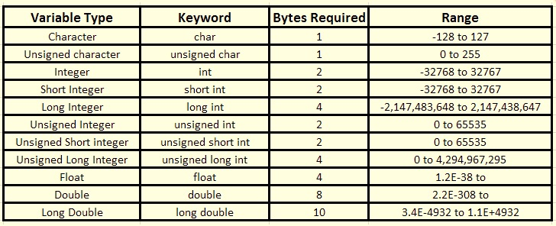
(4) cont.
Variables and Data Types

Slide 15
(4) cont.
➔Integer
int is used to define integer numbers
Int count = 5;
➔float
FLOAT is used to define floating point numbers
float count = 5.6;
➔char
char is used to define characters
char letter = ‘x’;

Slide 16
Outline
Software installation
Include statement and definition statements
Main method and file structure
Variables and data types
Arrays
Conditional statements
Loops and iteration statements
Registers names and data direction
Methods
Operators
Examples

Slide 17
(5) Arrays
Arrays is the group of elements saved in one group and each element has an index of its location that contains its value
All of its elements should have the same type
Index always starts from zero
0
0
0
0
0
0
12
45
3
7
0
0
int [6] x ;
/* Creates empty array of length 6 cells */
int [6] x = {12,45,3,7} ;
/* Creates array of length 6 cells shown in this page where the cells values are the values between the the curly braces */
/* notice that the rest of cells that not declared yet will have a value of 0 (default value of the integer type) */

Slide 18
(5) cont.
Two Dimensional Arrays
int [6][2] x ;
/* Create empty 2D-array of 6 cells */
x[1][1] = 12 ;
/* assign value 12 to cell (1,1)*/
x[3][0] = 20 ;
/* assign value 12 to cell (3,0)*/
x[5][1] = 10 ;
/* assign value 12 to cell (5,1)*/
Int temp = x[1][1] ;
/* temp in memory will have value of 12*/
0 | 0
0 | 12
0 | 0
20 | 0
0 | 0
0 | 10

Slide 19
Outline
Software installation
Include statement and definition statements
Main method and file structure
Variables and data types
Arrays
Conditional statements
Loops and iteration statements
Registers names and data direction
Methods
Operators
Examples

Slide 20
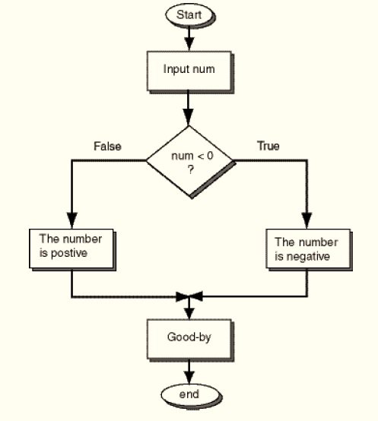
(6) Conditional Statement
Conditional statement gives you an option to make branches in the evaluated condition .. If the condition is true it would take certain otherwise it would take the other one like the following flow chart.
int num = 6 ;
if ( num < 0)
{
printf(“negative”);
}
else
{
printf(“positive”); }

Slide 21
(6) cont.
Conditional statement has two forms
switch
If-else
int month= 6 ;
switch (month)
{
case 1: printf(“JAN”);break;
case 2: printf(“FEB”);break;
. . .
case 12: printf(“DEC”);break;
default: printf(“error”);
break;
}
int num = 6 ;
if ( num < 0)
{
printf(“negative”);
}
else
{
printf(“positive”); }
Used for many branches instead Of nested if-else
Abscence of break will prevent the instruction to be printed and it will print the statement that has the first break.
In if-else statement the else is related to the closest if
More than one statement inside the if part or else part will need curly braces for the instructions

Slide 22
Outline
Software installation
Include statement and definition statements
Main method and file structure
Variables and data types
Arrays
Conditional statements
Loops and iteration statements
Registers names and data direction
Methods
Operators
Examples

Slide 23
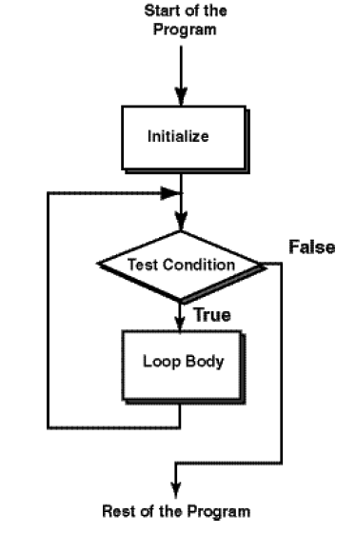
(7) Iteration Statements
Iteration Statement gives you chance to repeat certain group of operations more than one time if certain conditions validates true otherwise the iteration process will terminate according to the flow chart
Iteration Operations needs 3 main basic steps for their operation:
Initialization
Condition
Operation and update

Slide 24
(7) cont.
Iteration statement has three forms
Normal operation of the iteration process that evaluates condition before looping
int x = 5;
while ( x > 0 )
{
printf(“positive”); }
while
Execute the operation at least one time before evaluating the condition
O(n+1) not like the while loop that has O(n)
int num = 6 ;
{
printf(“positive”);
}
do ( x < 0 )
Do-loop
for (int x = 5 ; x < 0 ; x --)
{
printf(“positive”);
}
The simplest form of the iteration process and the most common used in counters
for
Update may be incrementation or decrementation or any other form

Slide 25
Outline
Software installation
Include statement and definition statements
Main method and file structure
Variables and data types
Arrays
Conditional statements
Loops and iteration statements
Registers names &data direction
Methods
Operators
Examples

Slide 26
(8) Register and Data
TRISX is used to define the direction of register X data to work as input or output and it is the register carrying the direction of the port X
PORTX is used to define the data of port X and it is the register carrying the data of this port
PORTXbits.RX4 is used to define the data of port X bit number 4 for example
Void main ( void )
{
TRISB = 0 ; // Make port B an output
TRISC = 1 ; // Make port C an input
PORTB = 0 ; // Assign value zero to port B
PORTCBITS.RC4 = 1; // Assign value 1 to bit 4 port C
}

Slide 27
Outline
Software installation
Include statement and definition statements
Main method and file structure
Variables and data types
Arrays
Conditional statements
Loops and iteration statements
Registers names &data direction
Methods
Operators
Examples

Slide 28
(9) Methods
Sometimes you need to break your program to smaller parts in order to have flexible and reliable program because the first step to solve any problem is to break it down to solvable smaller problems
So we have the main method the organizer to the class that will invoke any other method created inside the class
Take Care that : creating and calling methods in C is a little bit different from JAVA

Slide 29
(9) Cont.
#include <16f877a.h> ;
int add (int x , int y);
// the definition of the method should be written here
Void main ( void )
{
int a = 5;
int b = 7 ;
printf(“the result is =“ + add(a , b));
}
// method to be invoked by the main method in C- class
int add (int s , int r )
{
int z = s+r;
return z ; }

Slide 30
Outline
Software installation
Include statement and definition statements
Main method and file structure
Variables and data types
Arrays
Conditional statements
Loops and iteration statements
Registers names &data direction
Methods
Operators
Examples

Slide 31
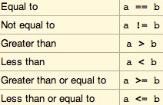
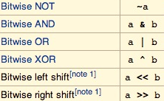
(10) Operators
Assume we have to operands a and b
Logical operators
Comparison operators
Bitwise operators

Slide 32
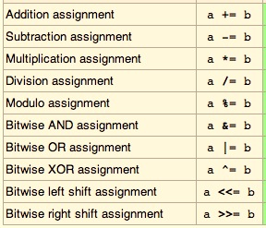
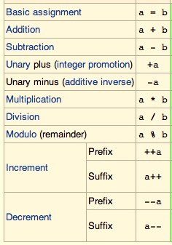
(10) Cont.
Assume we have to operands a and b
Compound operators
Arithmetic operators

Slide 33
Outline
Software installation
Include statement and definition statements
Main method and file structure
Variables and data types
Arrays
Conditional statements
Loops and iteration statements
Registers names &data direction
Methods
Operators
Examples

Slide 34
(11) Example (1)
Write a C18 program to toggle all the bits of port B continuously
#include <16f877a.h> ;// for TRISB and PORTB declarations
void main(void)
{
TRISB =0; // make Port B an output
for ( ; ; ) // repeat forever like while(ture)
{
PORTB = 0x55;
PORTB = 0xAA;
}
}

Slide 35
(11) Example (2)
Write a C18 program to send values 00-FF to port B
#include <16f877a.h> ;// for TRISB and PORTB declarations
void main(void)
{
unsigned char z;
TRISB =0; // make Port B an output
for (z=0;z<=255;z++)
PORTB =Z;
while (1); // needed If running in hardware
}

Slide 36
Thanks
Dr. Amr Talaat

